Slide 1
KRENICON és a kutatás továbbfejlesztése MEG

Slide 2
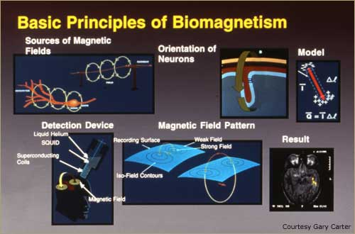
http://www.neurosurgery.pitt.edu/imageguided/meg/meg_biomagnetism.html

Slide 3
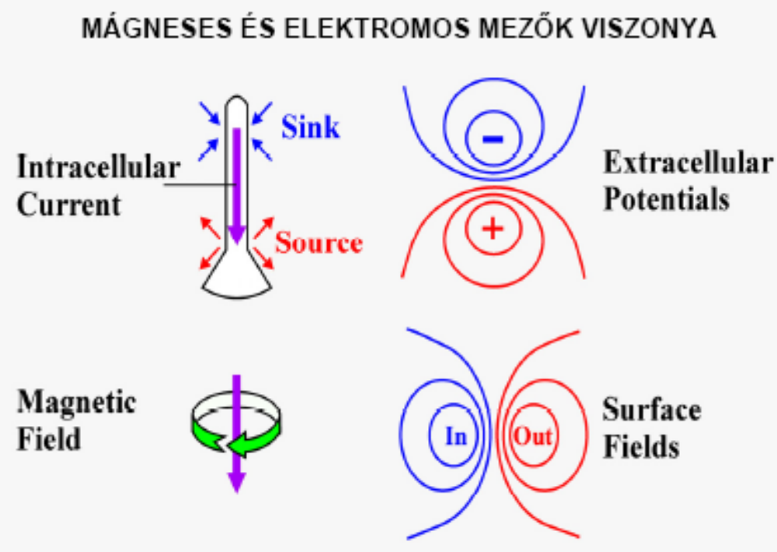
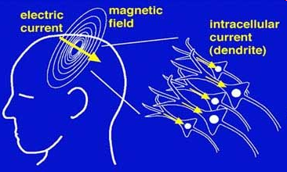
A magnetic field of 100fT (femto-tesla: 10-15 tesla) to several tens of is emitted from the heart. The earth's magnetic field is approximately 50µT (10-6 tesla),
thus the heart's magnetic field is approx. 1/1,000,000 that of the earth's field.
http://www.medgadget.com/archives/print/001159print.html

Slide 4
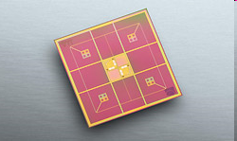
DETEKTOROK
SQUID SQUID (Super-conducting Quantum Inter-
ference Device) in a
YBa2Cu3O7-SrTiO3-YBa2Cu3O7
multilayer technology.
cooled to the temperature of :
Liquid Helium (about -273°C), can measure these tiny magnetic fields ( 4,2 Kelvin ),
Liquid Nitrogén -196°C ( 77 Kelvin ).

Slide 5
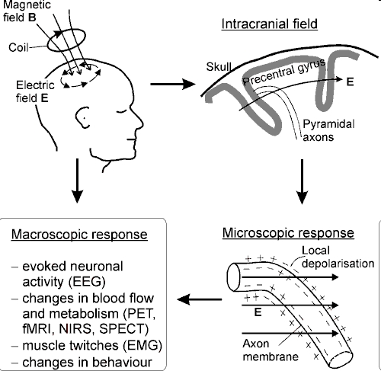
MAGNETOENCEFALOGRAPH MEG http://www.biomag.hus.fi/tms/Thesis/dt.html#2.2

Slide 6
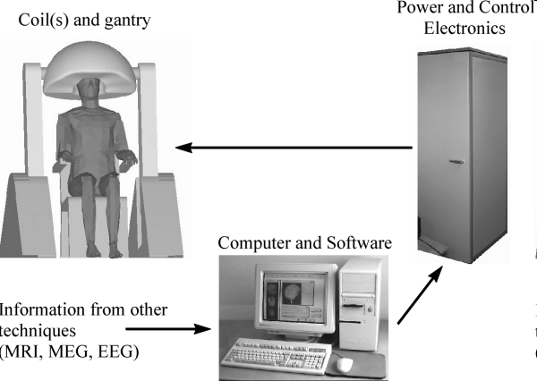
MAGNETOENCEFALOGRAPH MEG

Slide 7
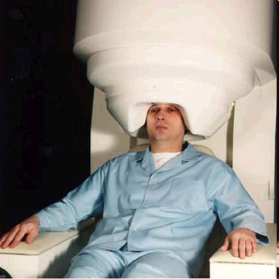
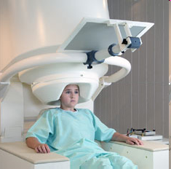
MAGNETOENCEFALOGRAPH MEG
CTF MEG™ Magnetoencephalography
Brain Imaging System
http://www.medgadget.com/archives/print/001159print.html

Slide 8
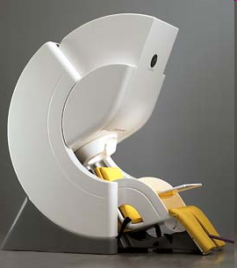
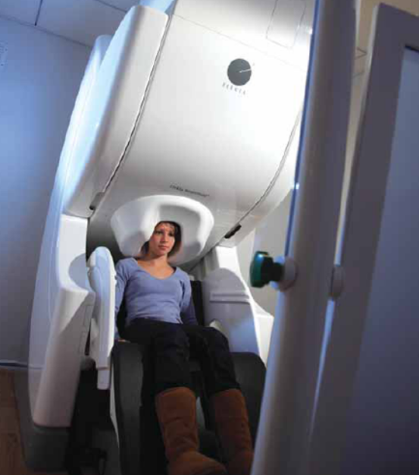
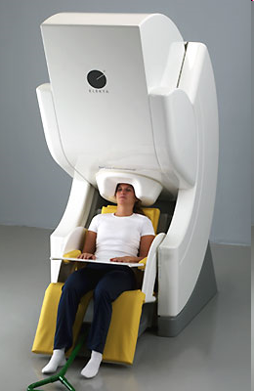
MAGNETOENCEFALOGRAPH MEG http://www.elekta.com/healthcare_us_functional_mapping.php
306 csatornás magnetométer
Nagyon nagy adatsűrűség
Nagyon hatékony zajelnyomás
Klinikai és kísérleti alkalmazásokra
Teljesítmény: 5 kW
Beépített 128 csatornás EEG
Saját adatfeldolgozó rendszer (4GB RAM, 14TB HDD)
Betegfigyelő kamerarendszer
Elekta Neuromag® MEG systems.

Slide 9
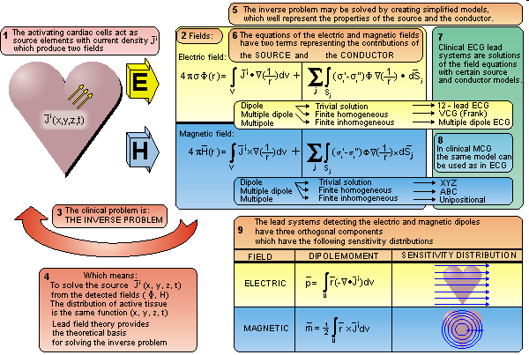
Magnetocardiography MCG

Slide 10
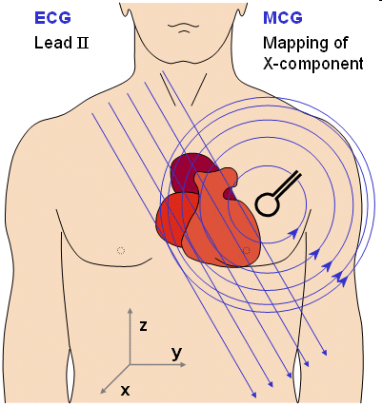
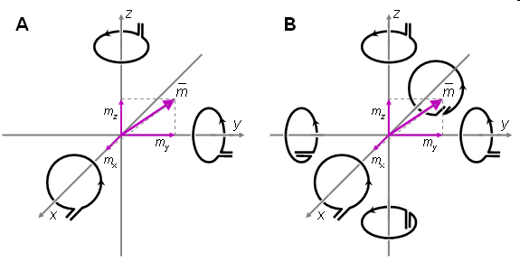
A natural method to measure the magnetic dipole moment of a source locating in the origin is to measure the x-, y-, and z-components of the magnetic field on corresponding coordinate axes. These may be either (A) unipolar or (B) bipolar measurements. www.bem.fi/book/20/20.htm
Magnetocardiography MCG

Slide 11
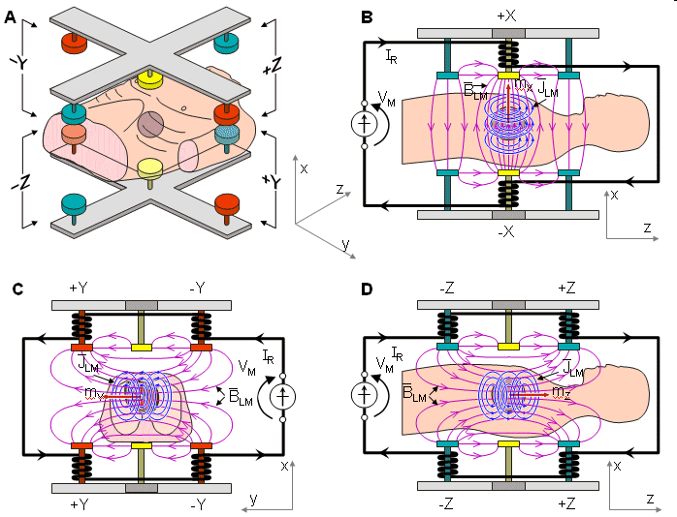
Magnetocardiography MCG

Slide 12
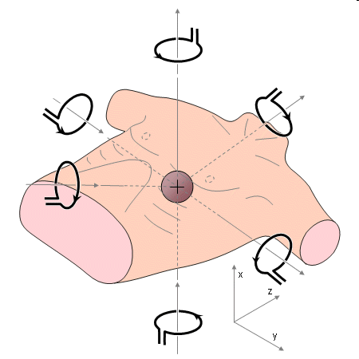
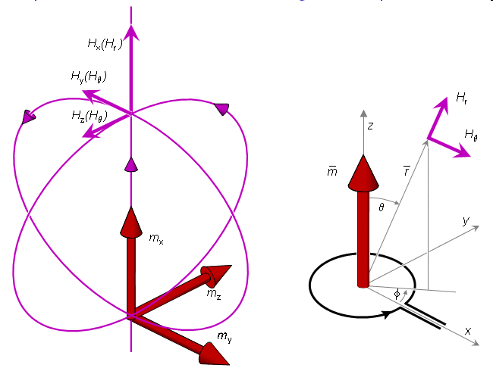
Symmetric XYZ lead system.
Magnetocardiography MCG
(A) The three components Hx, Hy, and Hz of the magnetic field due to the three components mx, my, and mz of a magnetic dipole .
(B) Components of the magnetic field of a dipole.
(A) (B)

Slide 13
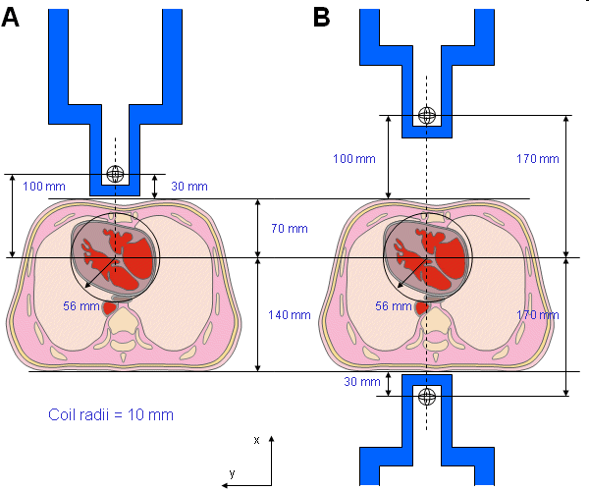
Dimensions for the thorax and heart models and the measurement distances in unipolar and bipolar unipositional measurements.
(A) Unipolar (nonsymmetric) measurement location on the anterior side.
(B) Bipolar (symmetric) measurement locations on the anterior and posterior sides.
Magnetocardiography MCG

Slide 14
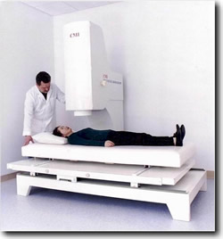
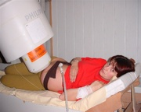
Magzati EKG
Magnetocardiography MCG

Slide 15
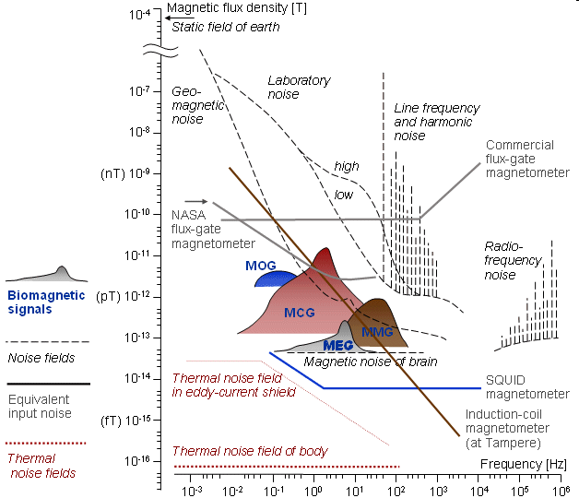
ZAJ SPEKTRÁLIS jellemzése

Slide 16
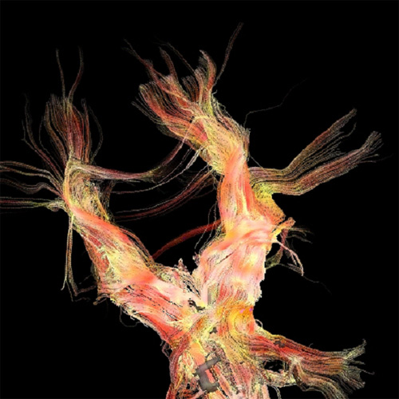
Köszönöm figyelmüket

